Slide 1

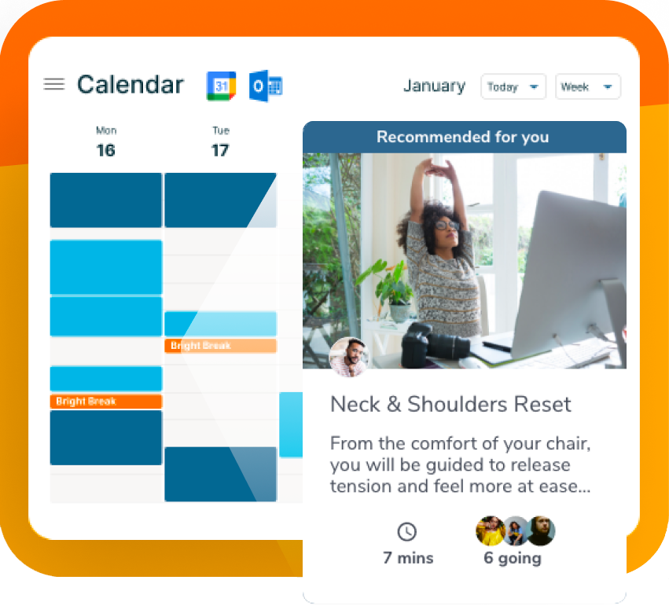
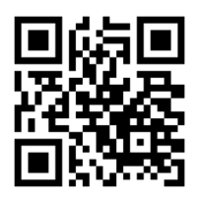
Keep moving, breathing and stretching through busy days.
Live 7-minute breaks morning and afternoon every weekday
Connect your calendar for automatic break reminders
Live + on-demand content inviting you to Move, Breathe, Stretch, Learn and Eat Well
Track your breaks on our team leaderboard!
Your well-being is a priority!
Create your account here with your work email: brightbreaks.com/signup

